Slide 1
Causal sensitivity analysis
Institute for ai in management
Frontiers in reliable causal inference under unobserved confounding
Dennis Frauen
Institute for AI in Management
LMU Munich

Slide 2

About me
Second year PhD student in Causal inference & Machine learning
Research interests
Treatment effect estimation
Off-policy learning
(Causal) algorithmic fairness
Partial identification & sensitivity analysis
Work published at ICML, ICLR, AAAI

Slide 3




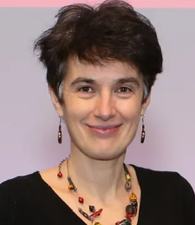
Collaborators
Valentyn Melnychuk
LMU Munich
Alicia Curth
University of Cambridge
Fergus Imrie
University of Cambridge
Stefan Feuerriegel
LMU Munich
Mihaela van der Schaar
University of Cambridge

Slide 4
Agenda
Introduction to causal sensitivity analysis
Novel approach for deriving sharp bounds
Closed-form solutions for special cases
Neural generative models for sensitivity analysis
Counterfactuals

Slide 5

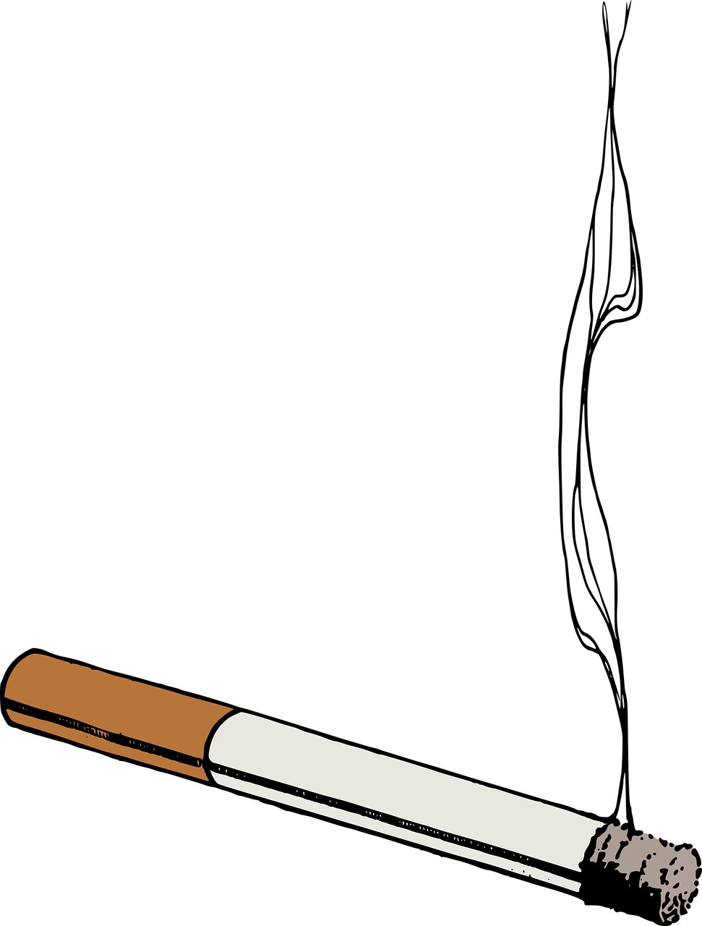
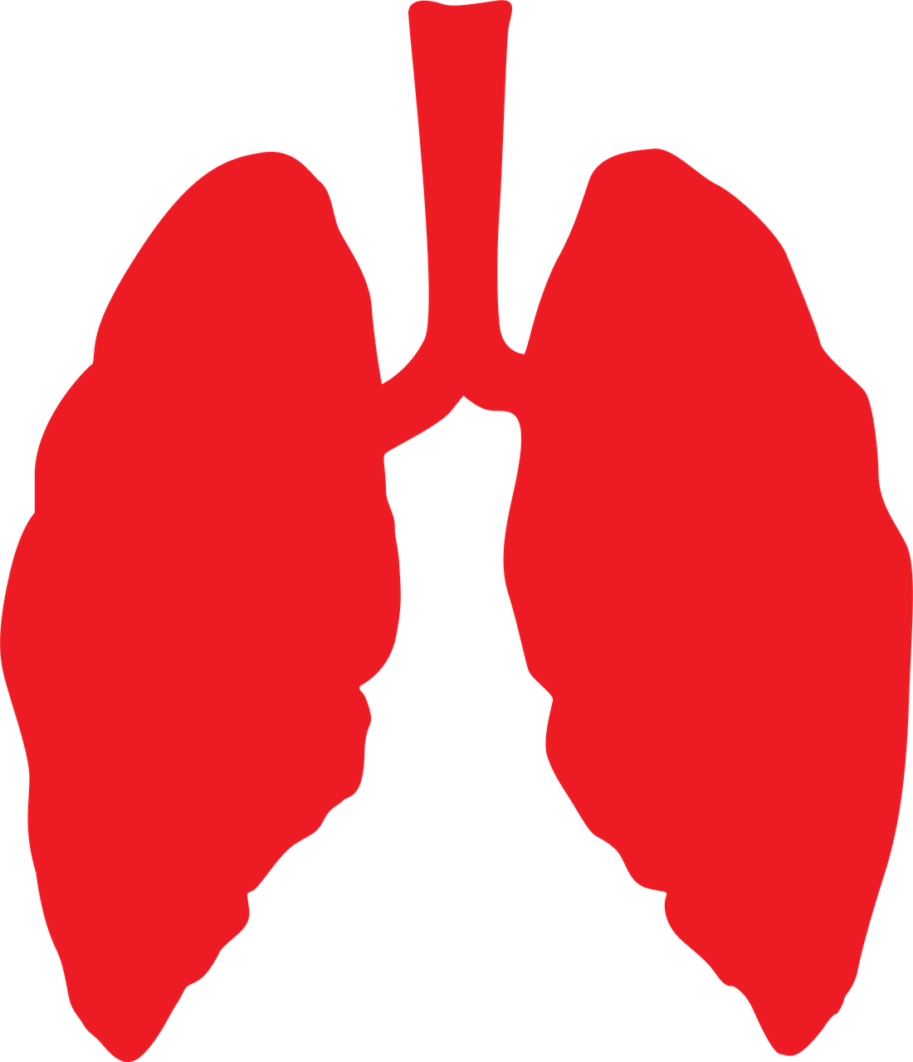
Motivation – Partial identification
Genes (unobserved)
Smoking
Lung cancer
Point identification
The causal effect is a function of the observed data distribution
Not possible under unobserved confounding
Partial identification
The causal effect is constrained by bounds
Bounds are functions of the observed data distribution
Unobserved confounding

Slide 6
Motivation – Sensitivity analysis
Genes (unobserved)
Smoking
Lung cancer
Large effect from smoking on lung cancer in the observational data
Can the effect be fully explained by unobserved confounders (genes)?
Cornfield (1959)¹: No! To fully explain away the observed effect, the genes would need to have an implausibly large effect on smoking.
1. J. Cornfield et al., Smoking and lung cancer: Recent evidence and a discussion of some questions. J. Nat. Cancer. Inst. 22. 173-203 (1959)

Slide 7
Overview on identification types
Can we exclude unobserved confounding?
Point identification
Can we restrict the strength of unobserved confounding?
Causal sensitivity analysis
Other assumptions: IV, discrete outcomes, etc.

Slide 8
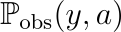
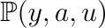
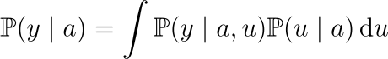
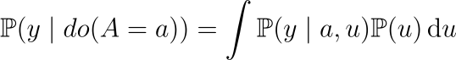
Formal problem setting
Basic setting
Treatment
Outcome
Unobserved confounder
Observed distribution
Full distribution unknown
Conditional vs interventional distribution
Conditional distribution
Interventional distribution
Objective
Causal query for some functional
Example:

Slide 9
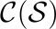
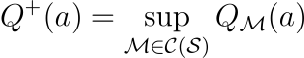
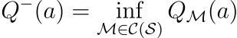
Causal sensitivity analysis
Restriction via sensitivity model
Main idea
Restrict the strength of unobserved confounding by using a sensitivity model
Find an informative region for the causal query (partial identification)
Partial identification problem
Consider the class of all SCMs that:
Respect the causal graph
Induce the observational distribution
Respect the sensitivity constraints imposed by
We aim at deriving the sharp bounds

Slide 10
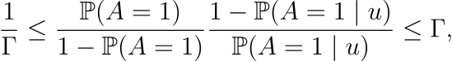
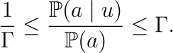
Sensitivity model examples
Binary Marginal sensitivity model (MSM)
Continuous marginal sensitivity model (CMSM)
-sensitivity models

Slide 11
Agenda
Introduction to causal sensitivity analysis
Novel approach for deriving sharp bounds
Closed-form solutions for special cases
Neural generative models for sensitivity analysis
Counterfactuals

Slide 12
Existing work & our contributions
Existing works derive (often closed-form) bounds for specific sensitivity models
Most existing methods only work for (conditional) average treatment effects and binary treatments
We propose a novel approach to causal sensitivity analysis
Interpretation of the bounding problem via probability mass transport
Compatible with many different sensitivity models
Sharp bounds for a variety of causal queries: CATE, distributional effects, mediation/ path analysis, interventional densities
Unified approach to causal sensitivity analysis

Slide 13
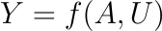
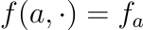
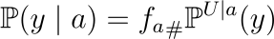
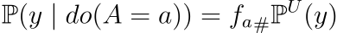
SCM framework
Conditional vs interventional distribution
Conditional:
Interventional:
SCM framework
Functional assignment
We define
Distributions as push-forward
Conditional:
Interventional:

Slide 14
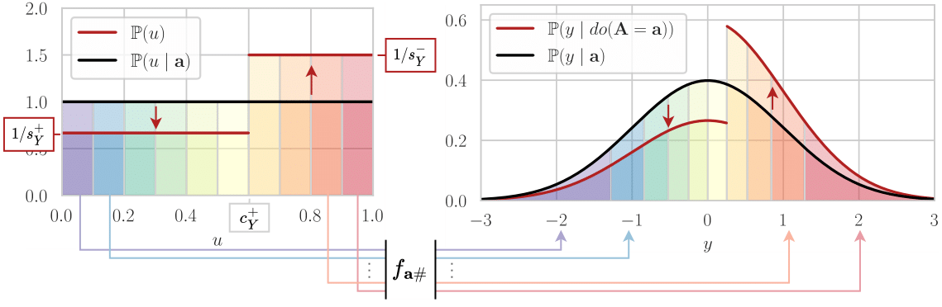
Bounding as probability mass transport

Slide 15
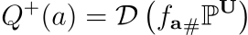
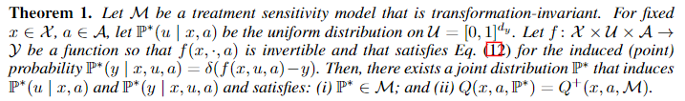
Idea: 2 step procedure
Distributions as push-forward
Conditional:
Interventional:
Our approach
Step 1: Fix and so that
Step 2: Maximize upper bound
by optimizing over subject to sensitivity constraints
Theoretical guarantees

Slide 16
Intuition

Slide 17
Agenda
Introduction to causal sensitivity analysis
Novel approach for deriving sharp bounds
Closed-form solutions for special cases
Neural generative models for sensitivity analysis
Counterfactuals

Slide 18
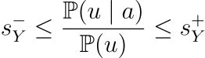
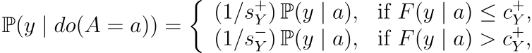
Bounds for the marginal sensitivity model (MSM)
MSM:
Maximally “right shifted” distribution:

Slide 19
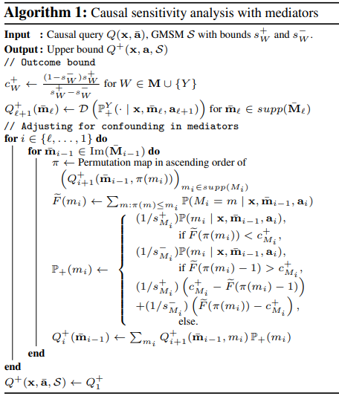
MSM bounds in more general settings
Basic idea extends to more general settings (details in paper):
Observed confounders
(Multiple) discrete mediators
Arbitrary (multidimensional) unobserved confounders
For binary treatments and (conditional) average treatment effects, we obtain the same bounds as Dorn and Guo (2023)²
They proved optimality by applying the Neyman-Pearson Lemma from statistical testing theory
2. J. Dorn and K. Guo, Sharp sensitivity analysis for inverse propensity weighting via quantile balancing. Journal of the American Statistical Association (2023)

Slide 20
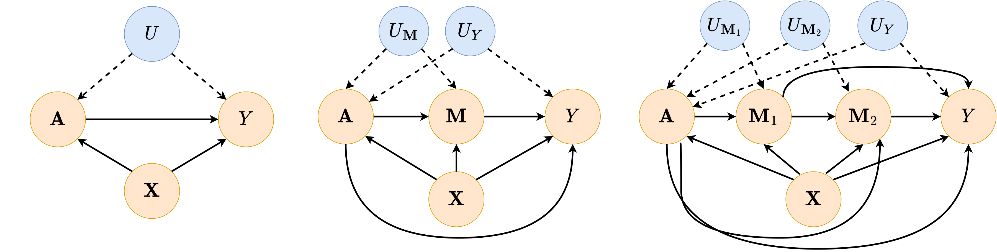
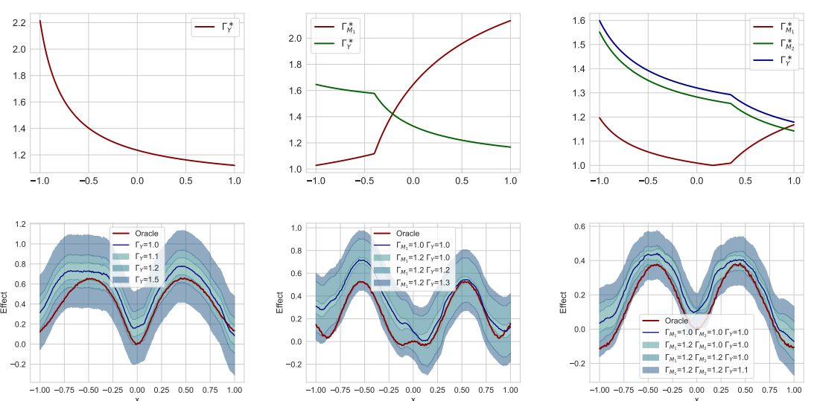
Experimental results: synthetic data

Slide 21
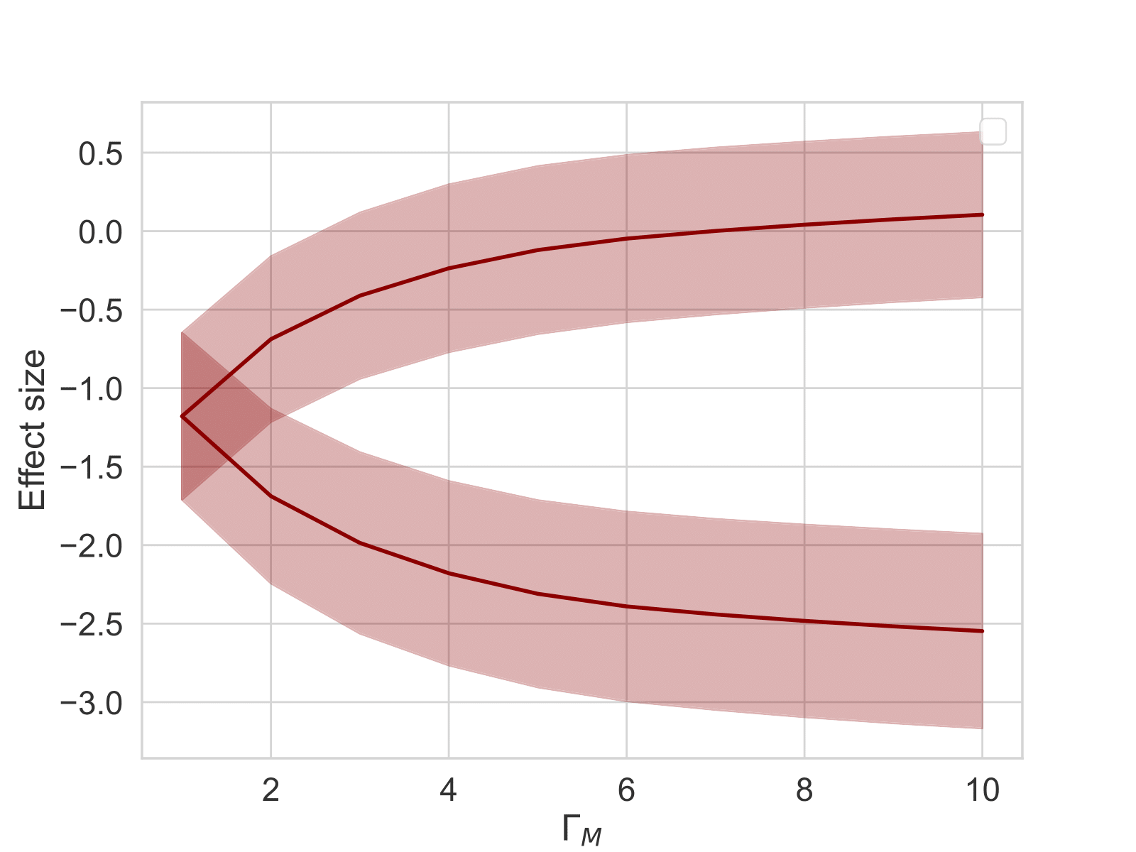
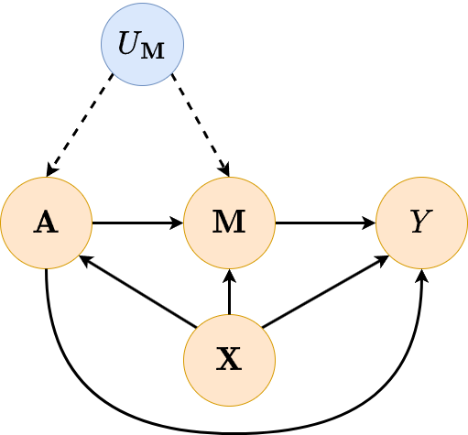
Results on real-world data: Covid-19 pandemic in Switzerland
Canton
Average natural direct effect
Mobility
Stay-at-home order
Infection rate

Slide 22
Agenda
Introduction to causal sensitivity analysis
Novel approach for deriving sharp bounds
Closed-form solutions for special cases
Neural generative models for sensitivity analysis
Counterfactuals

Slide 23
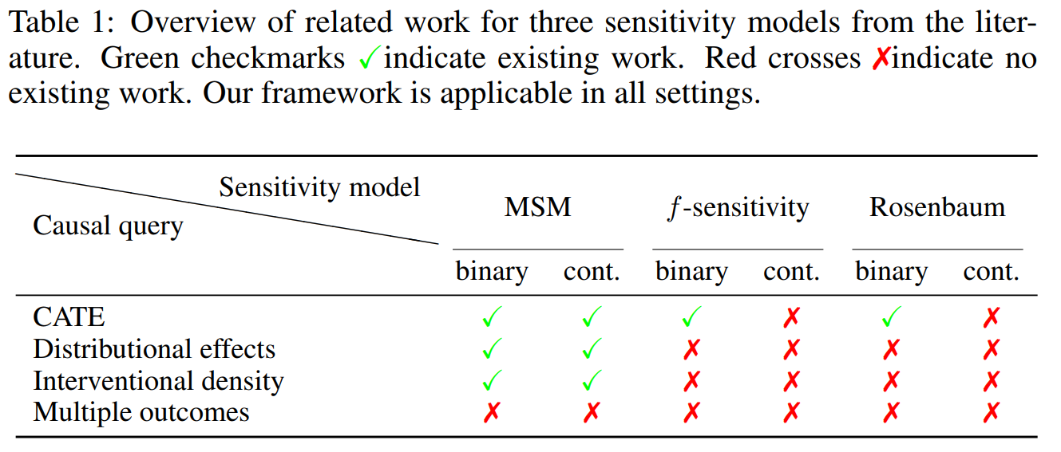
Related work/ contribution

Slide 24
Neural causal sensitivity analysis
General 2-step procedure
Step 1: Fix and so that
Step 2: Maximize upper bound
by optimizing over subject to sensitivity constraints
Neural causal sensitivity analysis
Step 1: Fix fit a conditional normalizing flow (CNF) to obtain
Step 2: Fit a second CNF on the latent space to learn a distribution that maximizes subject to sensitivity constraints

Slide 25
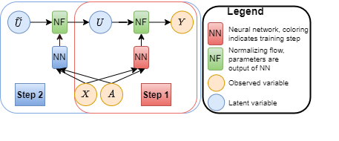
Model architecture
Intuition
Model architecture

Slide 26
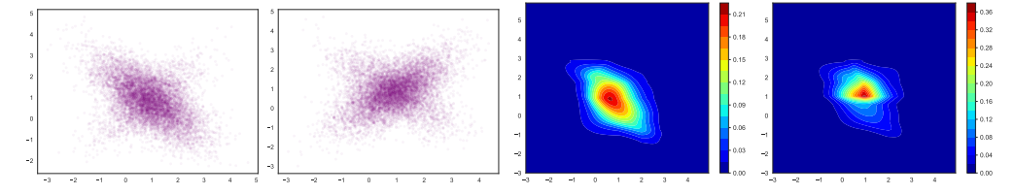
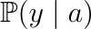
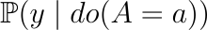
Example for 2D outcome distribution
Step 1
Step 2 for maximizing

Slide 27
Agenda
Introduction to causal sensitivity analysis
Novel approach for deriving sharp bounds
Closed-form solutions for special cases
Neural generative models for sensitivity analysis
Counterfactuals

Slide 28
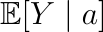
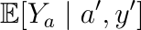
Pearl‘s causal hierarchy
Layer 1
Observational
Causal sensitivity analysis
Layer 2
Interventional
?
Layer 3
Counterfactual

Slide 29
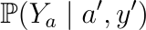
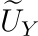
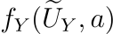
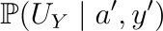
Setting
Object of interest:
Calculate via 3-step procedure (Abduction, Action, Prediction)
Action
Set in the SCM
where follows
Prediction
Compute
Abduction
Infer

Slide 30
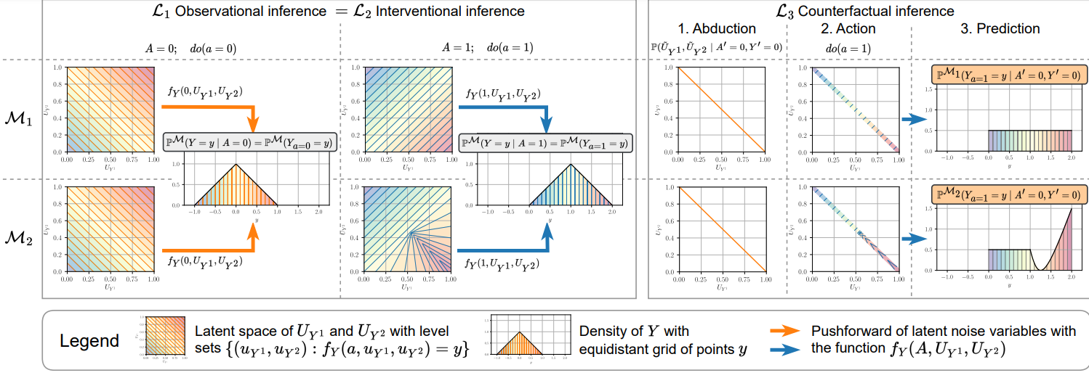
What can go wrong in layer 3?

Slide 31
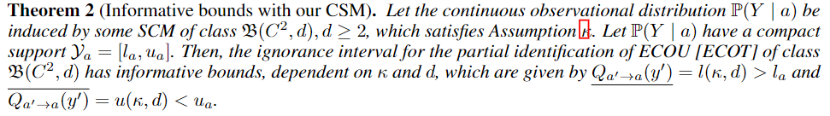
Curvature sensitivity model
Restricting the maximum principal corvature
Theoretical results

Slide 32
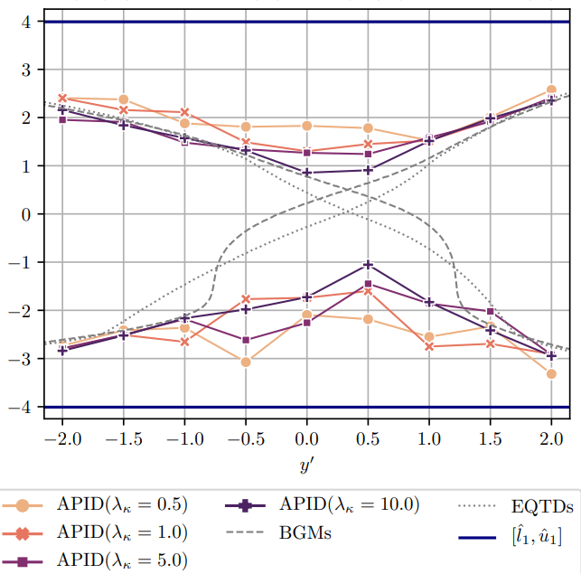
Augmented Pseudo-Invertible Decoder

Slide 33
Discussion
Summary
New way of thinking about sensitivity analysis/ partial identification via probability mass transport
Unified (neural) framework for causal sensitivity analysis
Closed-form solutions for MSM
Counterfactuals are difficult
Future work
Efficient estimation
Outcome sensitivity models
Different causal inference settings
Applications in causal ML (e.g., fairness, longitudinal data)
Counterfactuals! Sensitivity models, practical implementations, etc…

Slide 34
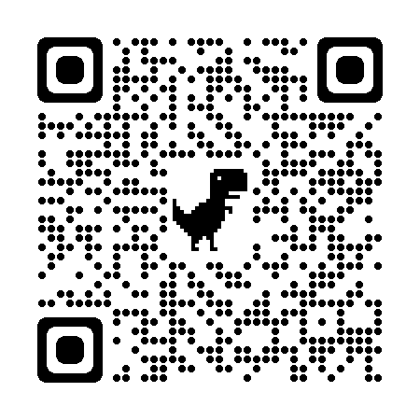
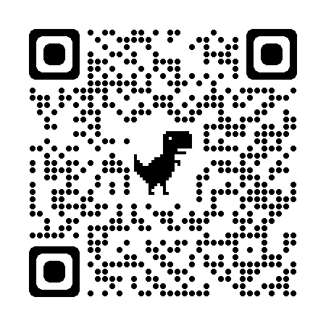
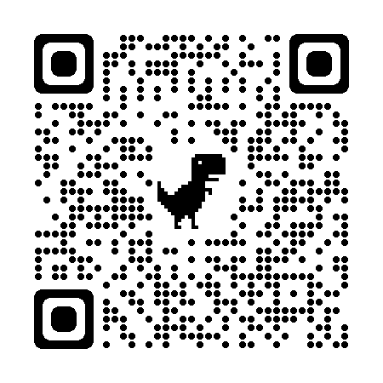
Links to papers
Coming soon!
Bounds for MSM-type sensitivity models
Neural causal sensitivity analysis
Counterfactuals
Dennis Frauen Institute of AI in Management
frauen@lmu.de

